Slide 1

Cybersecurity (SOC) Good Practices
Here is where the defence begins.

Slide 2
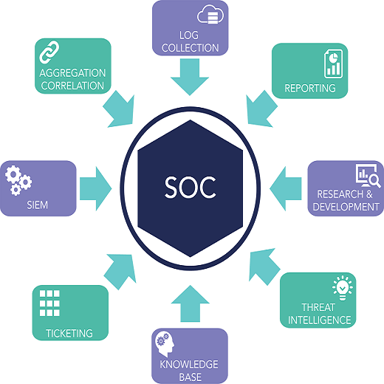
Basics of a SOC

Slide 3
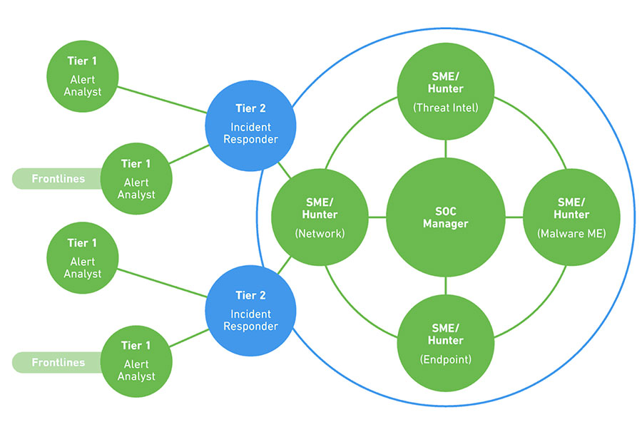
SOC Tires

Slide 4
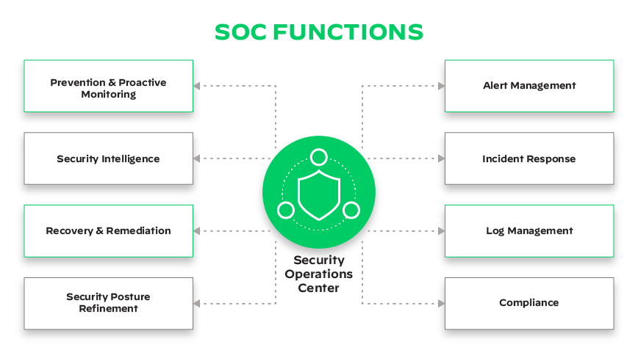

Slide 5
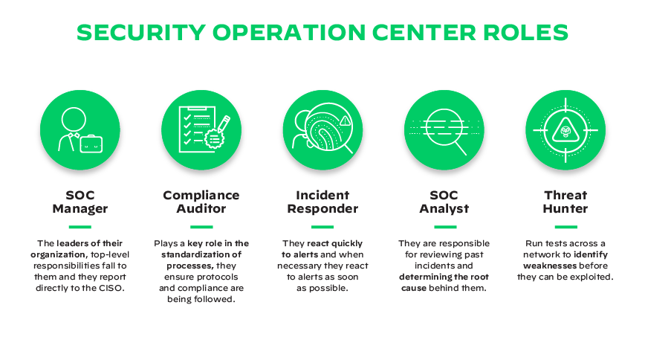
Key SOC Roles and Responsibilities

Slide 6
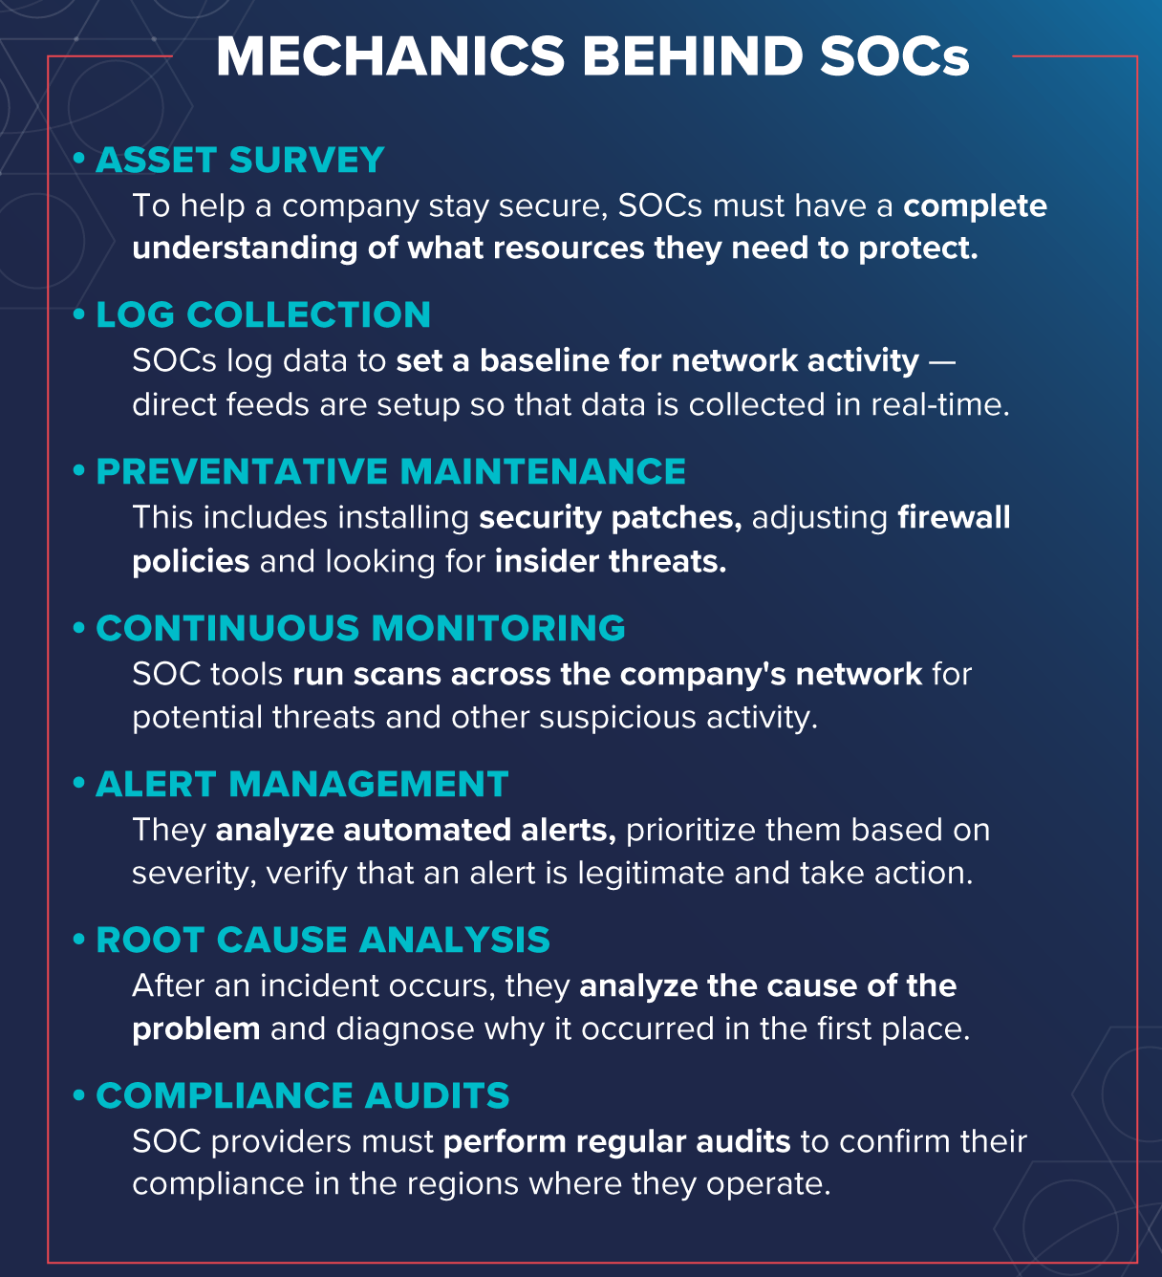
Standard SOC Operations

Slide 7
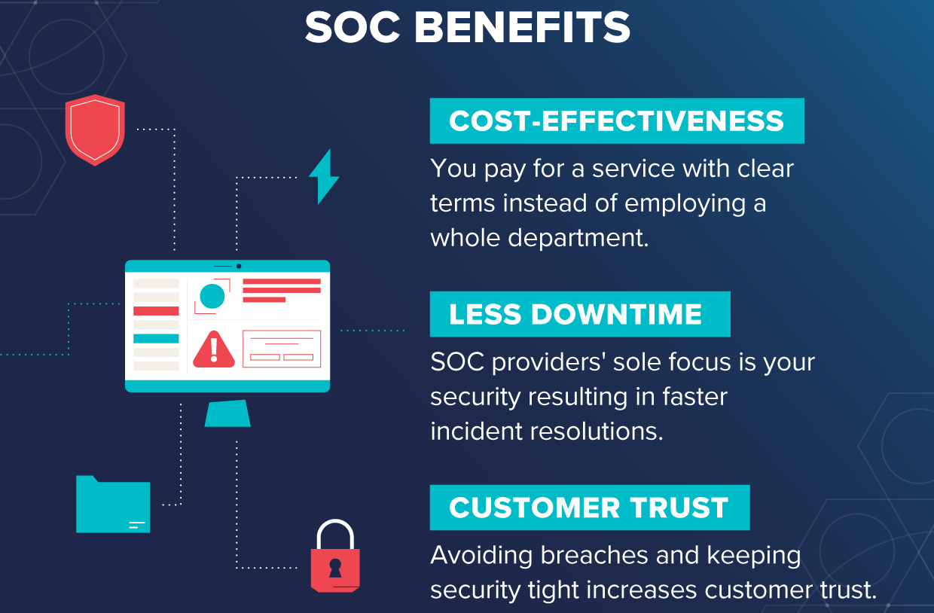
What are the Benefits of a SOC?

Slide 8
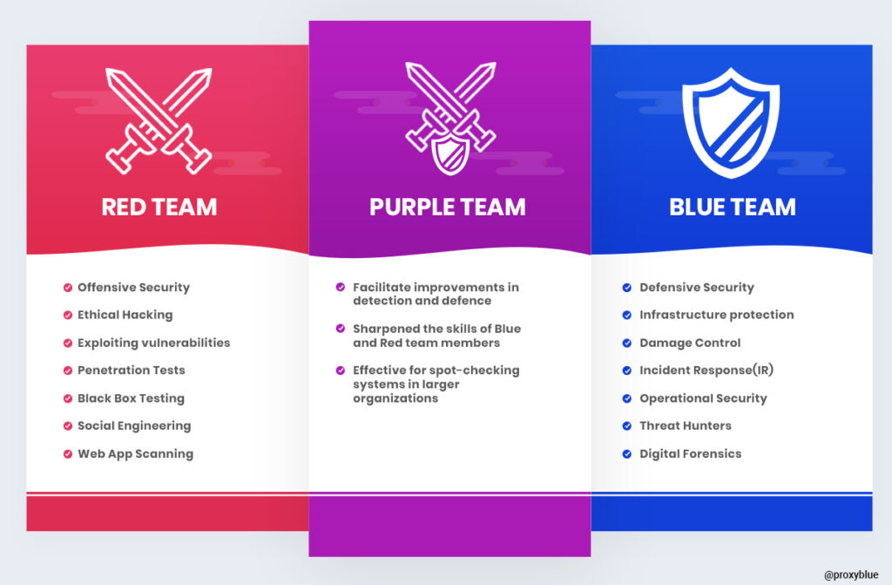

Slide 9
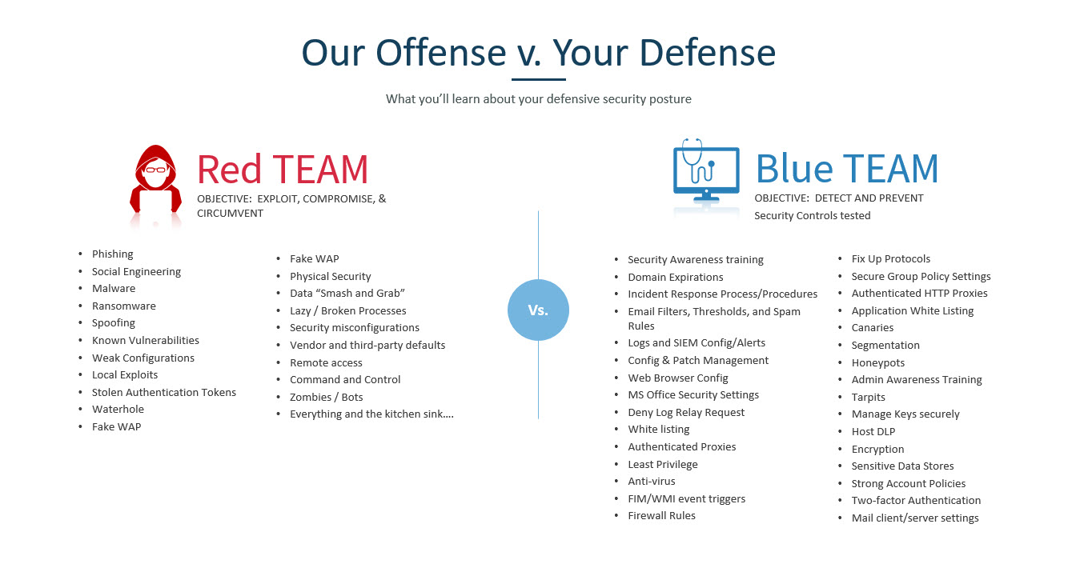

Slide 10
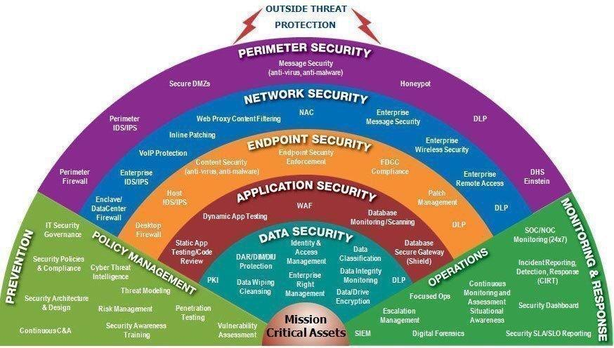

Slide 11
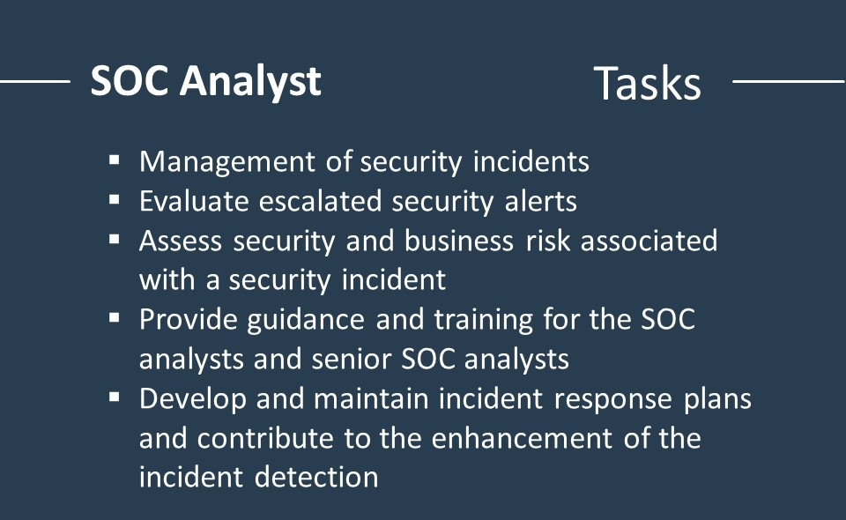
What are the responsibilities of a SOC Analyst

Slide 12
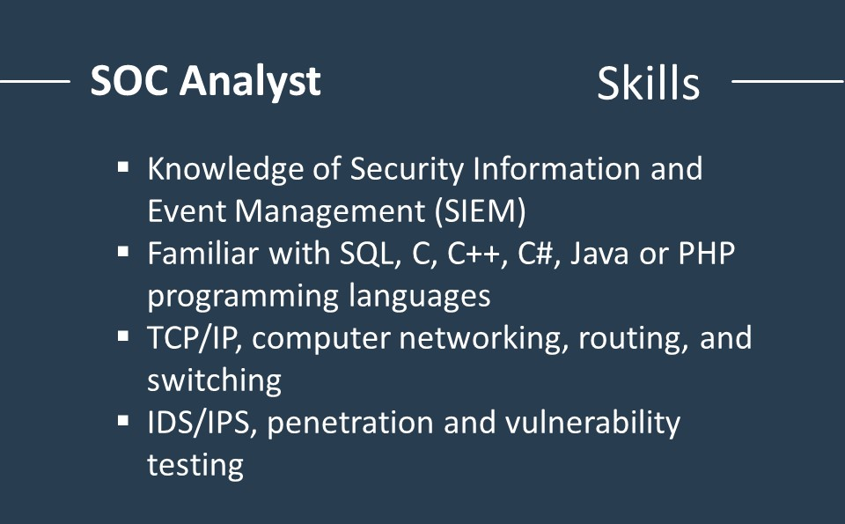
SOC Analyst Skills

Slide 13
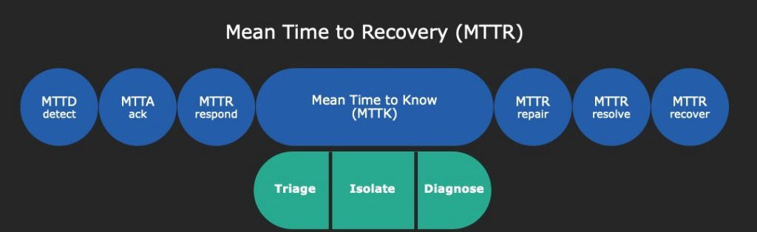
Stages of MTTR

Slide 14
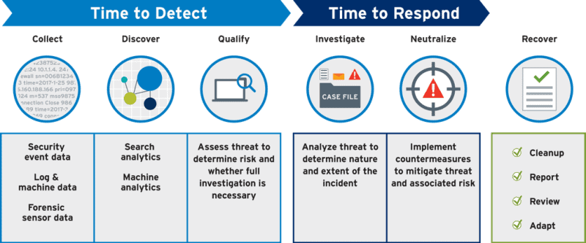
The Threat Lifecycle Management framework

Slide 15
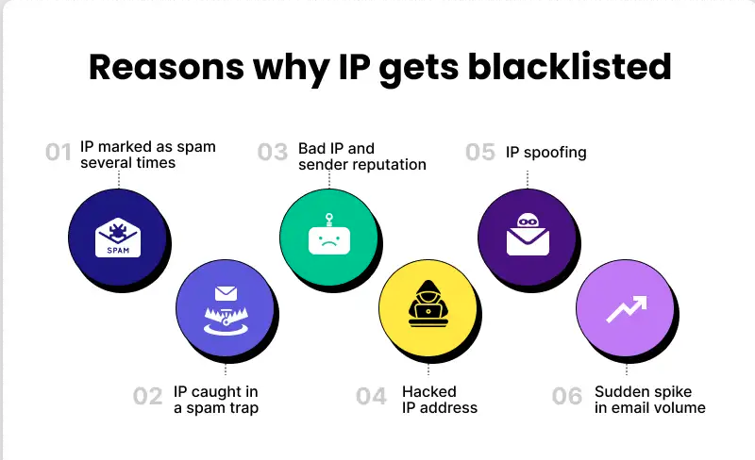
IP Reputation

Slide 16
IP Reputation checking Tools
AbuseIPDB
Spamhaus
MXToolbox
SORBS
Barracuda
DNSBL
VirusTotal

Slide 17

URL Reputation Tools
VirusTotal
Google Transparency Report
URL Void
Criminal IP
Sucuri SiteCheck

Slide 18





Online SandBoxes

Slide 19

